Slide 1
ECE20016-01/ITP20003 Java Programming
Executing a Java program
JC

Slide 2
Tentative Schedule
Weeks | Topics
1 | Introduction Java Runtime environments
2 | Object-oriented concept Packages and objects
3 | Class and its members
4 | Language Basics, Branching and Loop
5 | String and Number classes
6 | Arrays, Recursion
7 | Inheritance, Polymorphism, and Interfaces Abstract data type and Interfaces
8 | Basic data structures ArrayList
9 | HashMap Midterm Exam
10 | Exception Handling, Streams and File I/O (1)
11 | Streams and File I/O (2), Java Programming practice (1)
12 | Java Programming practice (2), Dynamic Data structure and Generics (1)
13 | Dynamic Data structure and Generics (2) GUI and Event-driven Programming (1)
14 | GUI and Event-driven Programming (2), Concurrency (1)
15 | Concurrency (2) , Summary
16 | Final
* This schedule can be modified according to the students’ performance and other reasons.

Slide 3
Agenda
Write our first (official) Java Program in Live!
Design our program first! (Draw simple class diagrams)
Create a package!
Create a java source code file for each object
Define a package in the source code file
Define a class
Define fields
Define methods
Compile all Java source code files!
Examples in the slides can't be compiled as there is no main method.
But look at the code in the lecture ;)
Run it!
Class members!

Slide 4
Agenda
main method
Compile java files and save class files in a different directory
Comments
Creating a jar file
Reading: https://docs.oracle.com/javase/tutorial/getStarted/application/index.html and next sections.

Slide 5
A very special method in Java: main method
An entry point of program execution
So, each program must have at least one main method!!
class MyClass{
…
public static void main(String[] args){
…
}
…
}

Slide 6
A main method! (2)
The main method accepts a single argument: an array of elements of type String.
This array is the mechanism through which the runtime system passes information to your application. For example:
$ java -cp [class path] com.myapckage.MyClass arg1 arg2
class MyClass{ … public static void main(String[] args){ … } … }

Slide 7
Classes in a different directory
Distributing only classes are basically enough to reuse classes.
Project directory may have separated sub directories for .java and .class files
bin (name can be anything like classes, etc. But `bin' is commonly used.)
src (a directory for .java files)
Classpath: a directory path where class files exist.
java -cp or java -classpath
Examples
./MyProject <-- a project directory name
src/edu/handong/csee/java/Calculator.java
javac -d bin /src/edu/hadnong/csee/java/Calculator.java
./MyProject <-- project directory
bin/edu/handong/csee/java/Calculator.class
java -cp bin edu.handong.csee.java.Calculator

Slide 8
Comments
Comments are ignored by the compiler but useful to other developers.
/* These are comments in a single line */
/* These are comments in multiple lines */
/** These are comments for Javadoc */
/** * These are comments for Javadoc * in multiple lines * /
Starting with a slash and double starts: /**
// This is a line comment.

Slide 9
Comments: Javadoc comments
Put Javadoc comments right before class, field, and method definitions. Note that only definitions with the 'public' modifier will be shown in Javadoc!!
/** * This is a class of Rider that creates an instance of Bicycle. */ public class Rider{ /** * This is a main method of the Rider class. */ public static void main(String[] args){ [...] }
Format: javadoc -d [path-to-save-javadoc] [source-file-names]
e.g. $ javadoc -d javadoc-directory edu/handong/csee/java/mypackagename/Test.java

Slide 10
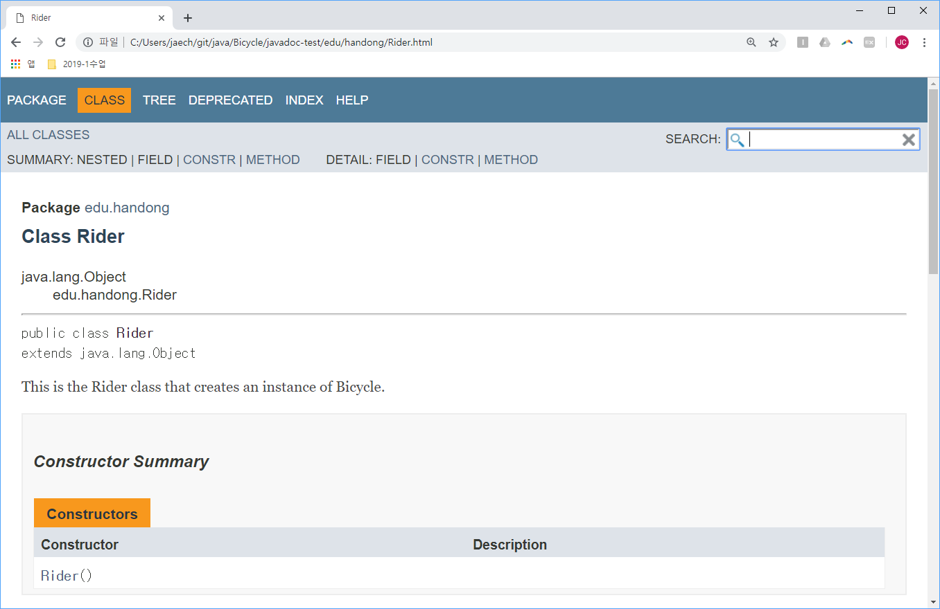
Comments: Javadoc comments

Slide 11
Javadoc tags
@author (classes and interfaces only, required) @version (classes and interfaces only, required. See footnote 1) @param (methods and constructors only) @return (methods only) @exception (@throws is a synonym added in Javadoc 1.2) @see @since @serial (or @serialField or @serialData) @deprecated (see How and When To Deprecate APIs)
http://www.oracle.com/technetwork/java/javase/tech/index-137868.html

Slide 12
Creating a Jar file
To distribute our classes to other developers.
Command $ jar -cvf Sugang.jar -C /path/to/your/package/path . e.g., jar -cvf MyJar.jar -C bin .
With this external jar file, other developers can reuse my classes for their Java program. $ javac -cp /path/to/MyJar.jar -d bin /src/your/package/*.java
If the jar file contains a main method, other uses can execute the program. $ java -cp /path/to/MyJar.jar com.package.name.MainClassName

Slide 13
Tentative Schedule
Weeks | Topics
1 | Introduction Java Runtime environments
2 | Object-oriented concept Packages and objects
3 | Class and its members
4 | Language Basics, Branching and Loop
5 | String and Number classes
6 | Arrays, Recursion
7 | Inheritance, Polymorphism, and Interfaces Abstract data type and Interfaces
8 | Basic data structures ArrayList
9 | HashMap Midterm Exam
10 | Exception Handling, Streams and File I/O (1)
11 | Streams and File I/O (2), Java Programming practice (1)
12 | Java Programming practice (2), Dynamic Data structure and Generics (1)
13 | Dynamic Data structure and Generics (2) GUI and Event-driven Programming (1)
14 | GUI and Event-driven Programming (2), Concurrency (1)
15 | Concurrency (2) , Summary
16 | Final
* This schedule can be modified according to the students’ performance and other reasons.

Slide 14

TODOs
Read all topics here: https://docs.oracle.com/javase/tutorial/java/concepts/index.html Read Ch9.3 (p.348~353)
JC Nam, jcnam@handong.edu, https://lifove.github.io

